Slide 1
opium alkaloids

Slide 2
Opium
Opium is the dried latex obtained by incision of unripe capsule of Papaver somniferum L.
Belong to the family Papaveraceae.
9.5-15% of morphine is present in raw opium.
Opium contains about 25 alkaloids included morphine, codeine, thebaine, noscapine, heroin , apo- morphine and papaverine and this are important alkaloids.

Slide 3
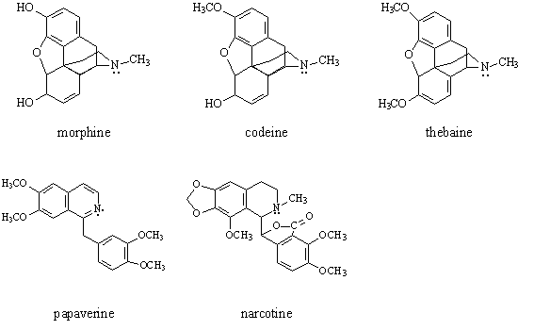
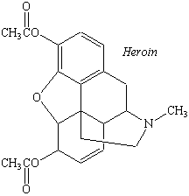
Harvesting opium poppies
When the flower petals were fallen off, after 10 days and before the maturity of the capsule, the capsule cut or scored by knife, this process done in the afternoon. The opium latex oozes through these cuts and in the next day the capsules latex are collected.
Heroin

Slide 4
Uses of Opium alkaloids
Morphine: causes depression action on central nervous system, due to narcotic principle. It is also used as sedative, analgesic, hypnotic and anti-spasmodic drug.
Codeine: it less sedative than morphine and useful in cough preparations. Regular uses of code. also produce constipation.
Papaverine: is useful in muscular spasms as smooth muscle relaxant action.
Noscapine: is a non-narcotic compound and useful as anti-tussive agent.
Morphine and heroin cause drug addiction in which heroin is more dangerous drug.

Slide 5
How is morphine work?
Morphine is one of the most famous painkillers.
It's an opioid drug, which has been used socially and in medicine thousands of years.
These drugs bind to the opioid receptors which are on the surfaces of nerve cells in the brain and spinal cord.
Morphine receptors are also found on nerves all over the body. To cite on example, the nerves that supply the muscles in the gut are slowed down by morphine; this can cause severe constipation, which patients taking opioid drugs need to be made aware of.

Slide 6
Opium alkaloids proprieties
1- Morphine (the free base) is only sparingly soluble in chloroform and insoluble in ether or benzene.
2- Codeine like morphine in its action, but it much weaker. Soluble in alcohol (2ml/1gm) and water (120ml/1gm) and very soluble in chloroform (0.5ml/1 gm).
3- Noscapine is insoluble in water, sparingly soluble in cold alcohol, it is insoluble in cold alkali but soluble in hot alkali.
4- Papaverine insoluble in water, slightly soluble in cold alcohol.

Slide 7
Procedure:
1- Take 5 gm of plant and put it in beaker with 200 ml of acidic alcohol (methanol 20%+ HCL + water).
2- String for 24 h. overnight.
3- Filter the extraction, take the filtration.
4- Add NH3 to 50 ml of extract until the pH become 10-11.
5- We will note the p.p. in the extract.
6- Detected the extraction by use Dragendroff reagent.
7- Filter the extraction
8- The precipitate contain noscapine, papaverine and thebaine.
9- The alklin solution contain codaine and morphine.
10- Put the sol. In S.F. and add chloroform 10 ml to it, the morphine will be in the aqueous layer and codeine in organic layer .

